Slide 1
Finally a Quiz today! :D
Generating Images with Gans

Slide 2
Today’s objectives
Quiz
Assignment #5
Any questions of Final Project proposal? (due today)
Review
Convolutional Neural Network

Slide 3
Review: neural net architectures seen so far
Basic:
Perceptron
For text:
RNN: Recurrent Neural Net
LSTM: Long Short Term Memory RNN
Why do we need different architectures again?

Slide 4

Dropout: discard some output to prevent overfitting
A fully connected layer: all information from the previous layer’s neurons goes to every neuron in the next layer
Output Layer
Hidden Layers
Notes:
Image source: Srivastava, Nitish, Geoffrey Hinton, Alex Krizhevsky, Ilya Sutskever, and Ruslan Salakhutdinov. "Dropout: a simple way to prevent neural networks from overfitting." The journal of machine learning research 15, no. 1 (2014): 1929-1958.

Slide 5
Dropout: discard some output to prevent overfitting
A fully connected layer: all information from the previous layer’s neurons goes to every neuron in the next layer
A dropout layer can prevent overfitting by randomly dropping information from neurons between layers
Notes:
Image source: Srivastava, Nitish, Geoffrey Hinton, Alex Krizhevsky, Ilya Sutskever, and Ruslan Salakhutdinov. "Dropout: a simple way to prevent neural networks from overfitting." The journal of machine learning research 15, no. 1 (2014): 1929-1958.

Slide 6
Dropout: discard some output to prevent overfitting
One main idea is that forgetting some things prevents potentially irrelevant information from impacting decisions, and forces the most important information to be what survives forgetting.
Notes:
Image source: Srivastava, Nitish, Geoffrey Hinton, Alex Krizhevsky, Ilya Sutskever, and Ruslan Salakhutdinov. "Dropout: a simple way to prevent neural networks from overfitting." The journal of machine learning research 15, no. 1 (2014): 1929-1958.

Slide 7
LSTM: Long Short Term Memory RNN
Intuition: we can be more careful about managing memory than the naive hidden state in an RNN that remembers everything equally
Notes:
Gate images: pintrest

Slide 8


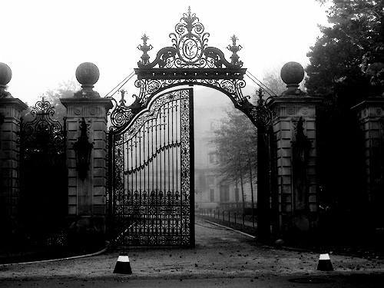
LSTM: Long Short Term Memory RNN
LSTM adds 3 gates to manage memory
💀
💀
The Gate of Forgetting
What past hidden state is worth keeping (still relevant) or no:
(0 forget - 1 keep) * past
The Gate of Input
What past hidden state will be useful to figure out this input?
Input + (remembered past)
The Gate of Output
What out of past state + this current input will be useful later?
Notes:
Gate images: pintrest

Slide 9
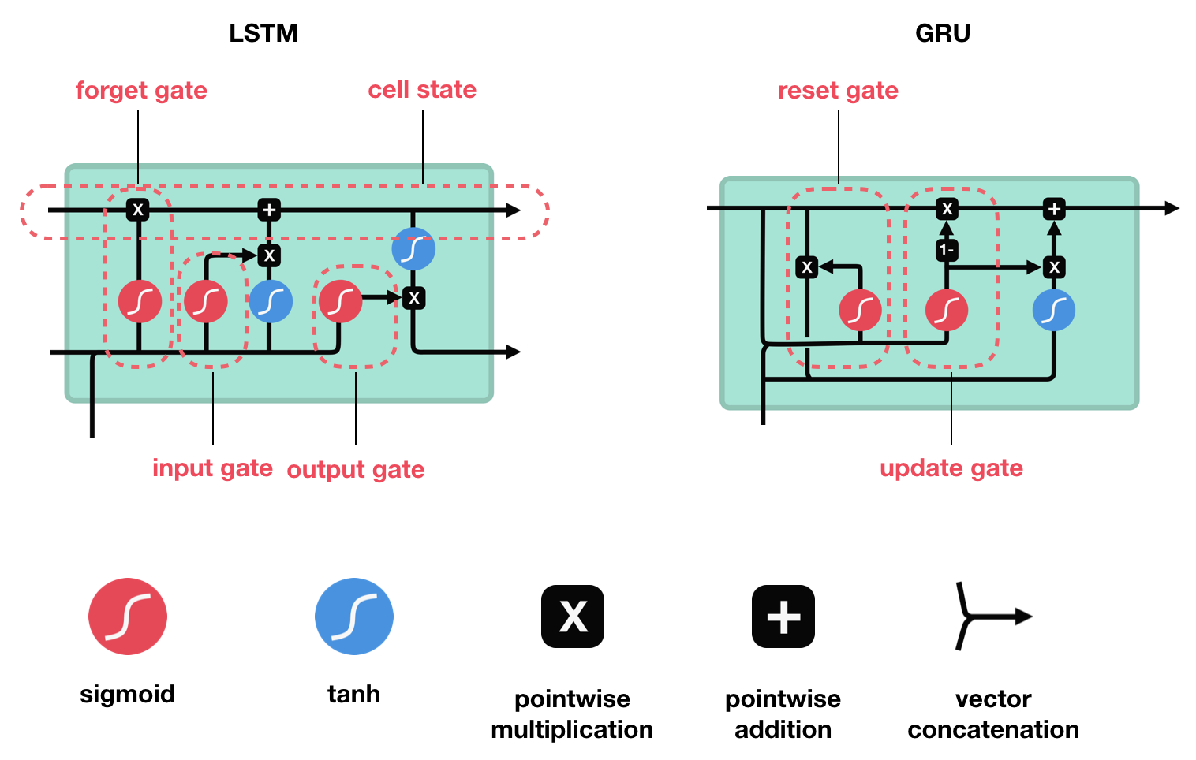
LSTM model (a neuron is now called a cell)
LSTM also adds a long term memory (cell state) to complement a more short term memory (hidden state).
Prior cell state
*New* Cell state
Prior hidden state
*New* hidden state
New input

Slide 10
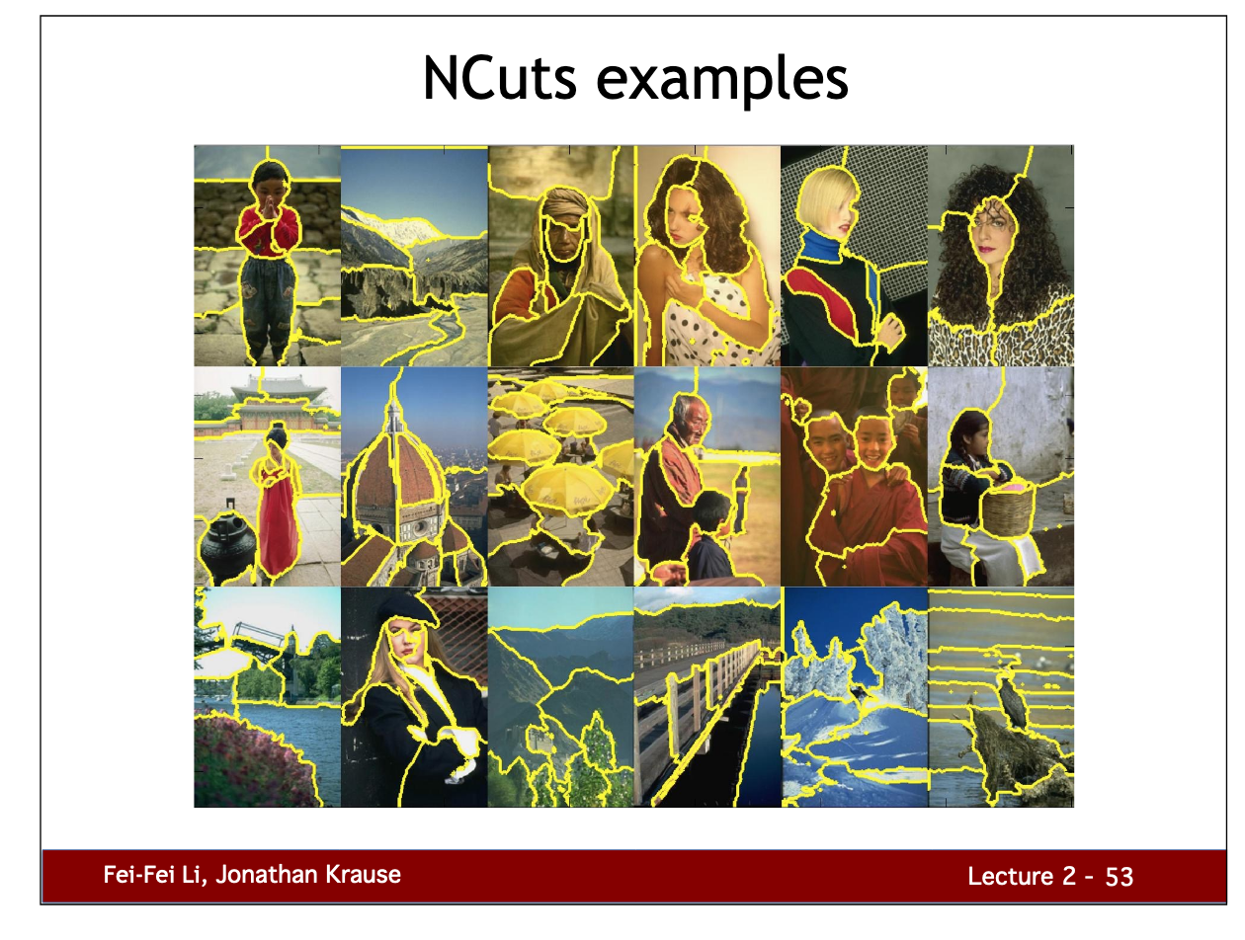
The “good” old times in computer vision
“Superpixels” were computed to reduce the number of pixels
Improve classification accuracies
Speed things up
Maxcuts a popular graph algorithm to do it.
Notes:
http://vision.stanford.edu/teaching/cs231b_spring1415/slides/lecture2_segmentation_notes.pdf

Slide 11
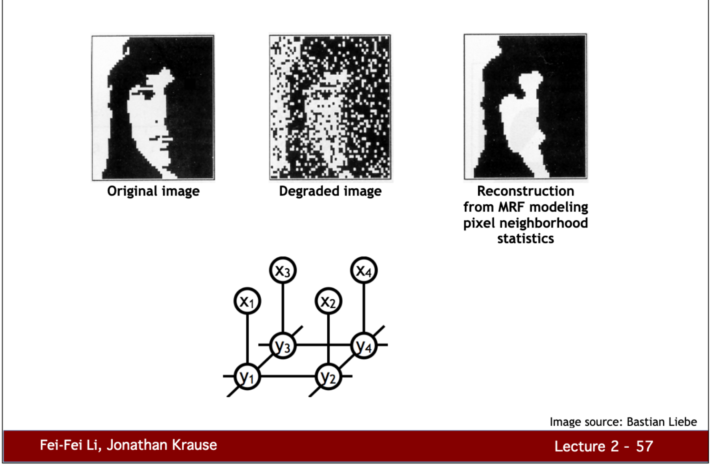
The “good” old times in computer vision
You could also learn specific models to find these super pixels.

Slide 12
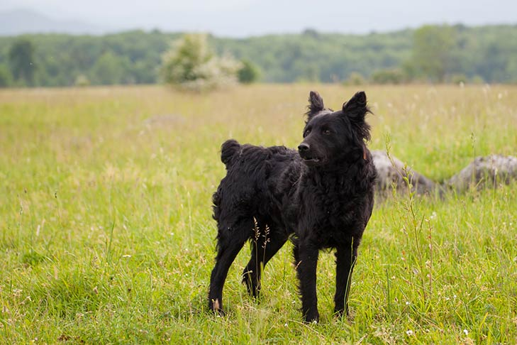
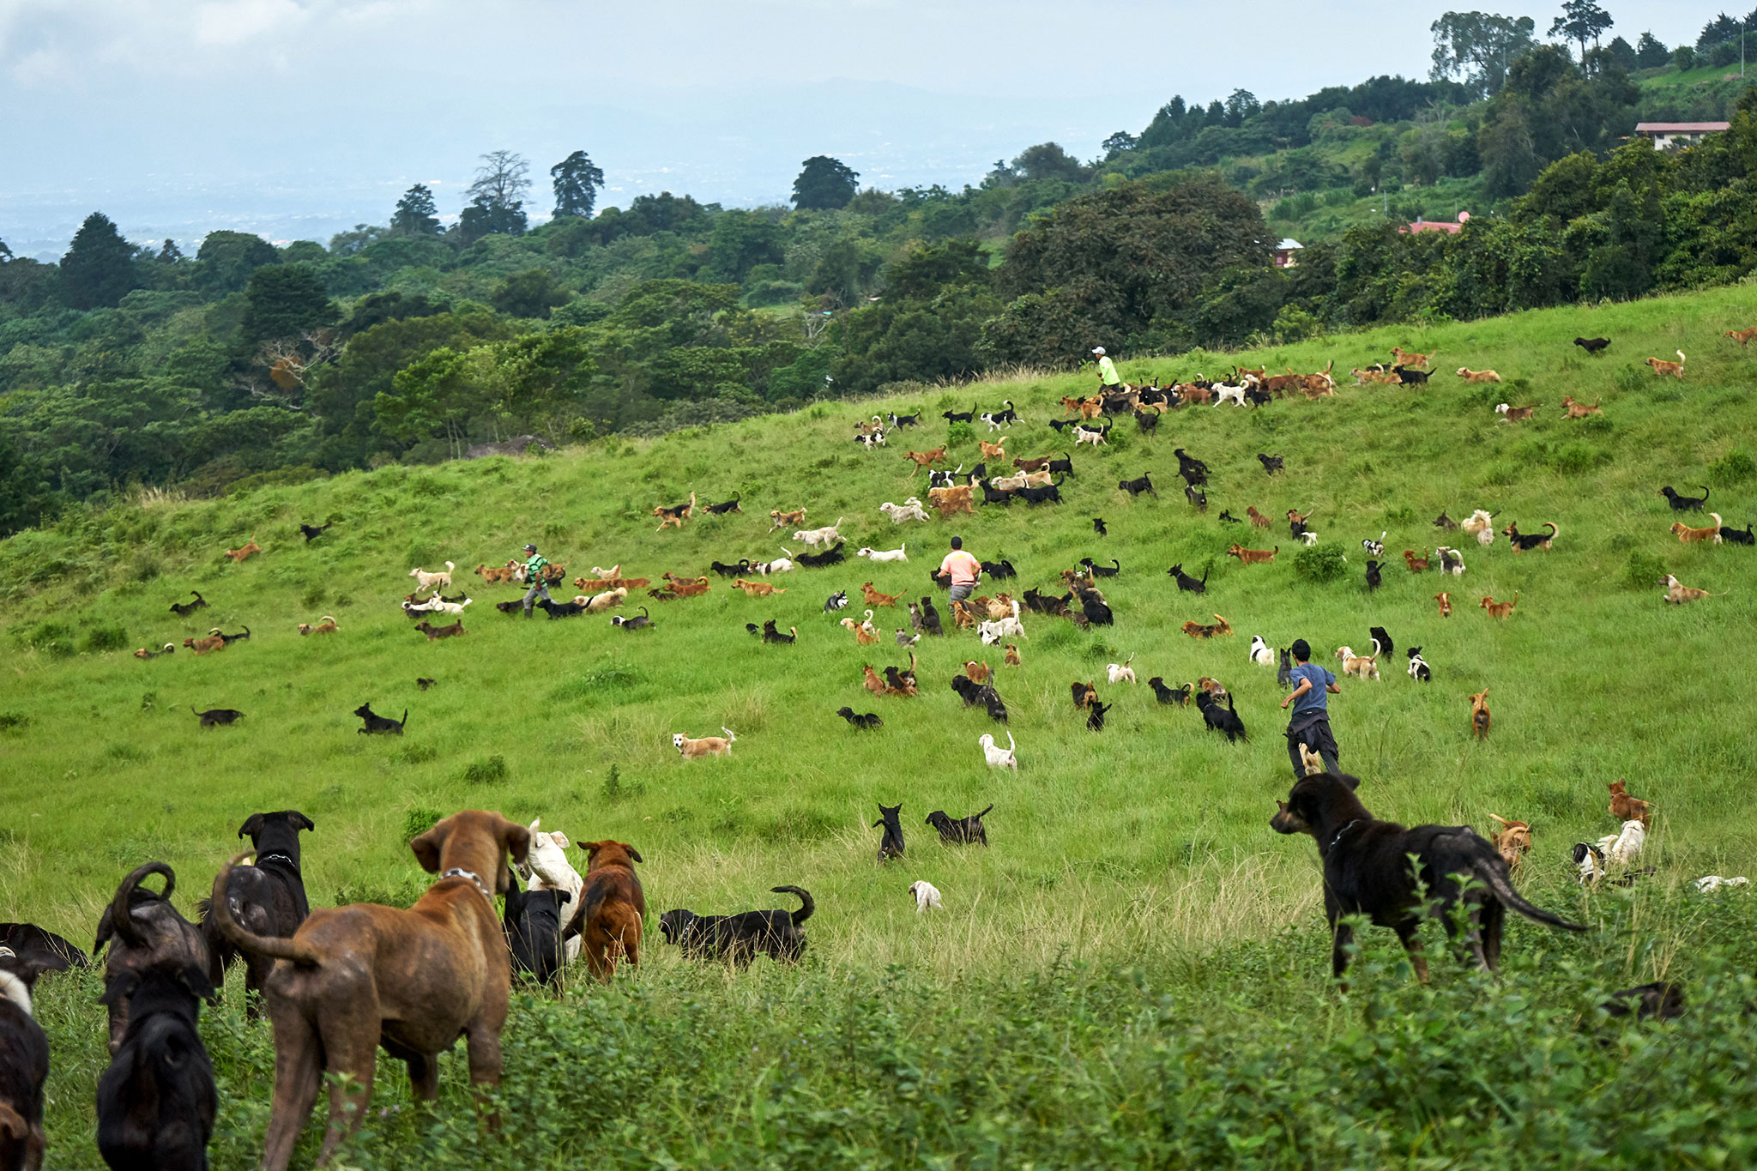
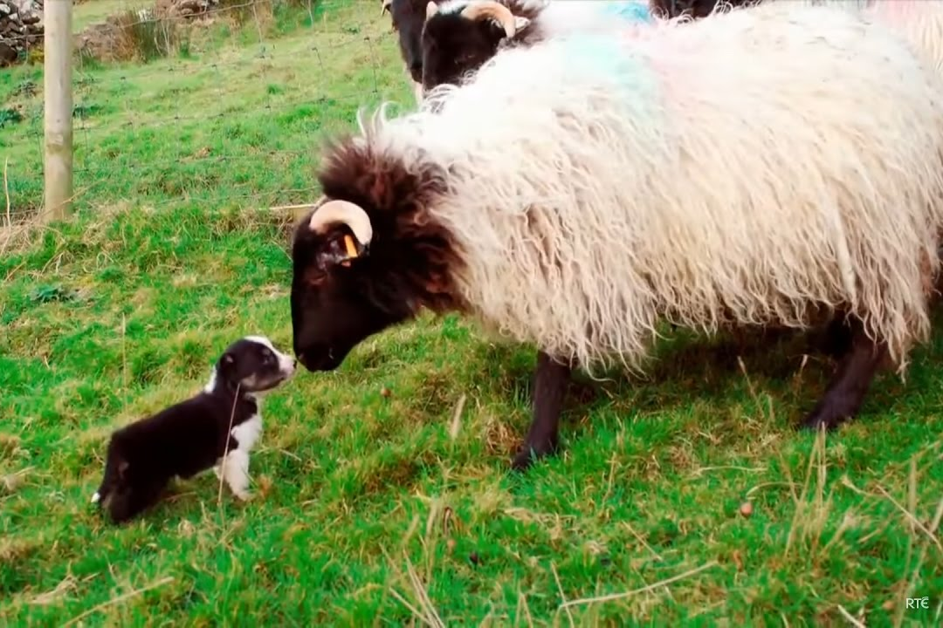
CNN: Convolutional Neural Net
CNNs are a type of multilayer perceptron most commonly used for image tasks.
We add a concept of “memory” to process serial data. What kind of abilities might a neural net need for vision?
Croatian sheepdog
Costa Rica stray dog estate
Herding pup in training
Notes:
Image: https://www.akc.org/dog-breeds/croatian-sheepdog/, https://www.nationalgeographic.com/photography/proof/2017/11/land-of-strays/,
https://www.youtube.com/watch?v=ZFZkBiQu31w

Slide 13
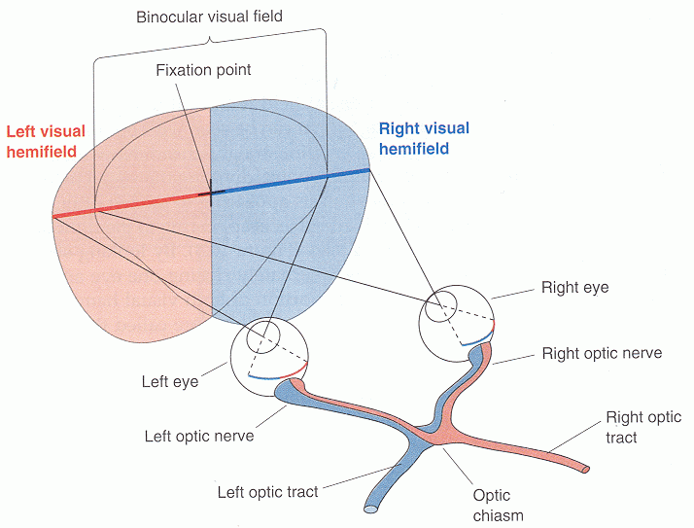
Human visual perception
CNNs are inspired by our brain’s own visual cortex.
We take in an “image” as what we see in our full visual receptive field.
Break down an image into subparts.
Each visual neuron is responsible for a small part of the receptive field.
Neurons partially overlap their receptive field. What is the benefit of doing so?
Higher layers of neurons combine the info from lower layers to perceive abstract visual information (“cat”)
Notes:
Image: http://fourier.eng.hmc.edu/e180/lectures/eye/node4.html

Slide 14
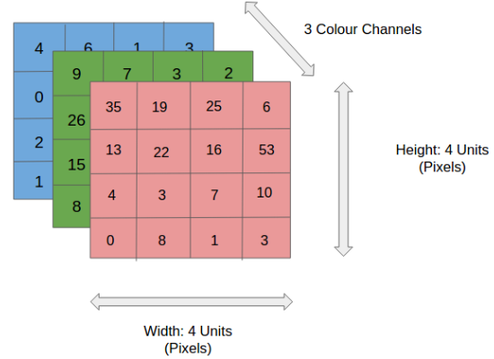
CNN building blocks: Input and Output Layers
Input Layer will be a colored RGB image
Output layer will be a classification of the image

Slide 15
CNN building blocks: Convolution
In yellow, there is a 3x3 convolution with a stride (movement) of 1.
The yellow is where a neuron is “looking” at the image
The pink convoluted feature is a summary of what each neuron “sees” in its yellow receptive field
Notes:
Image: https://towardsdatascience.com/a-comprehensive-guide-to-convolutional-neural-networks-the-eli5-way-3bd2b1164a53

Slide 16
CNN building blocks: Convolution in a color image
Notes:
Image: https://towardsdatascience.com/a-comprehensive-guide-to-convolutional-neural-networks-the-eli5-way-3bd2b1164a53

Slide 17
CNN building blocks: Padding
Since each neuron “summarizes” its receptive field into a single value, a convolutional layer will output a smaller matrix than what it started with.

Slide 18
CNN building blocks: Padding
To keep an image from shrinking between layers, we can use a technique called padding.
Padding just adds enough empty space to the input that it will “shrink” to be the actual image size.

Slide 19
CNN building blocks: Pooling
Pooling is the opposite to padding.
A pooling layer takes a convoluted feature after the convolution layer, and shrinks it again.
Max pooling = just take the max value, throw out the rest.
The purpose to to reduce computational complexity and prevent overfitting.

Slide 20

CNN: Full architecture summary
Notes:
Image: https://towardsdatascience.com/a-comprehensive-guide-to-convolutional-neural-networks-the-eli5-way-3bd2b1164a53

Slide 21
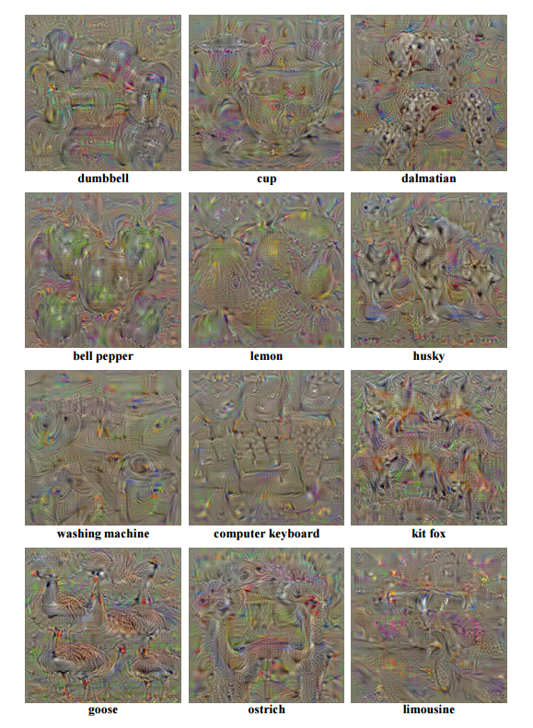
What are CNNs really seeing?
These gradient generated images are meant to be an image that will cause very high activation for the CNN to belong to that category.
More details: https://distill.pub/2017/feature-visualization/
Notes:
Image: https://courses.engr.illinois.edu/ie534/fa2019/GAN.html

Slide 22
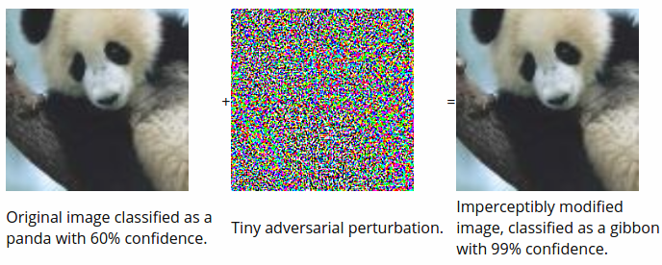
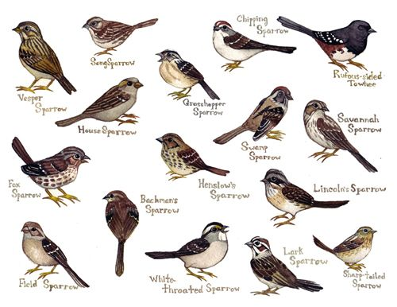
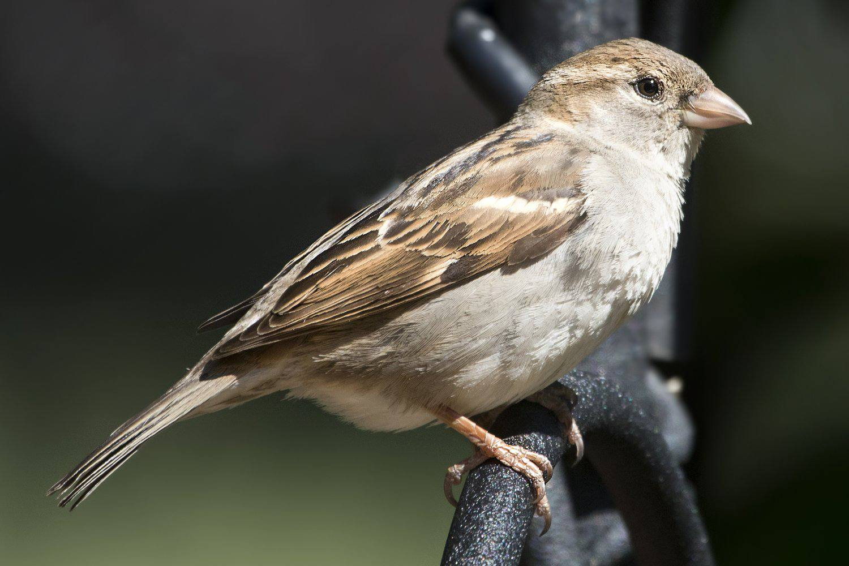
How to trick a CNN versus how to trick a human
Trick a CNN
Trick a human
Notes:
Bird images: pinterest and The Spruce
Panda: https://arxiv.org/abs/1412.1897

